Slide 1
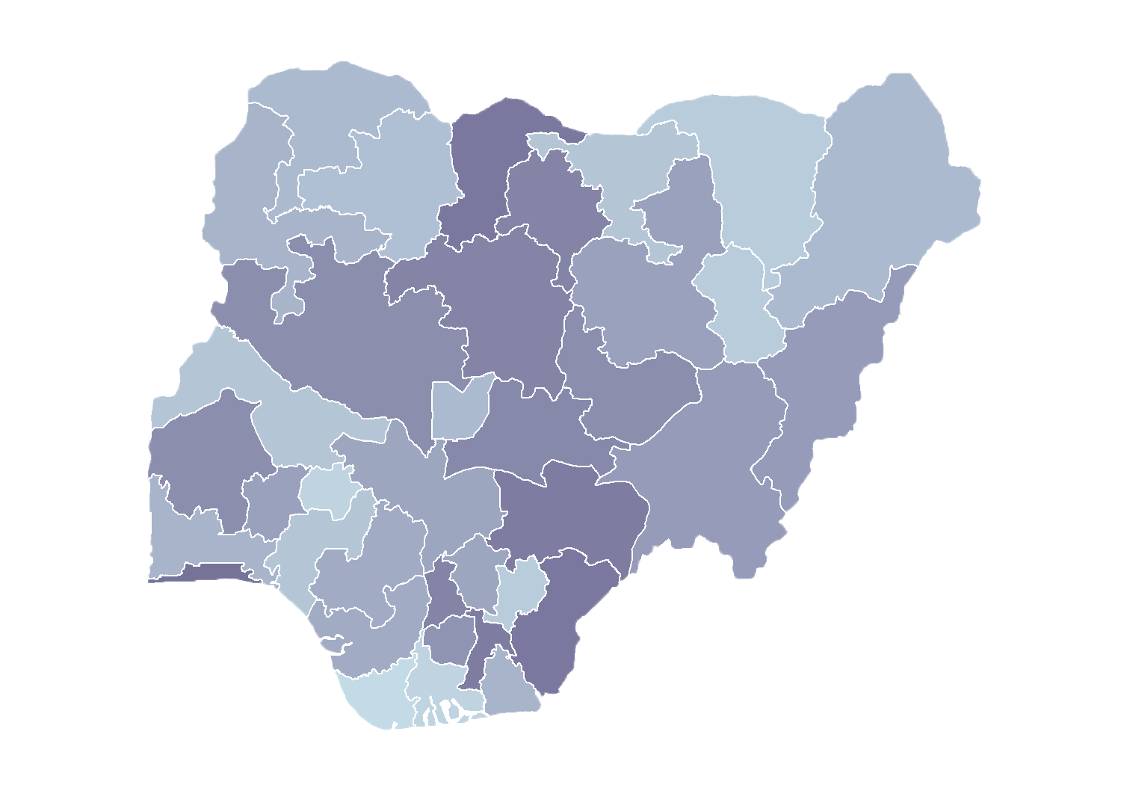

Module 2.2
Introduction to
Global Positioning Systems
Rollout of Health Facility Registry/Master Facility List
for States and Local Government Areas
in Nigeria
March 2019

Slide 2
Outline
Gain basic understanding of global positioning systems (GPS), including satellites in orbit
Learn how to create a waypoint using the Garmin eTrex20

Slide 3
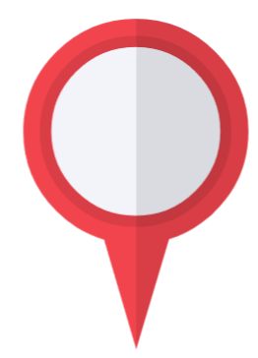
GPS basics

Slide 4
Global positioning system
What is GPS?
GPS is a satellite-based system that
can be used to locate positions
anywhere on the earth
  A worldwide radio-navigation system
  Uses satellites as reference points
  to calculate positions
Operated by the U.S. Department of Defense (DOD)—full operation 1994
  Initially developed for military applications but later access was given to civilian users

Slide 5
Other navigation systems
In addition to GPS, other systems are in use:
    A worldwide radio-navigation system: The Russian GLObal NAvigation Satellite System (GLONASS)—full operation in 2007
    European Union Galileo positioning system—its operation started in 2016
    Chinese Compass navigation system—in operation since 2000
    Indian Regional Navigational
    Satellite System

Slide 6
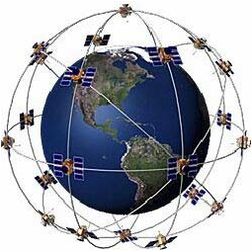
Global positioning system
GPS and satellites
GPS (USA) – 31 satellites
GLONASS (Russia) – 24 satellites
Galileo (European Union) – 14 satellites
BeiDou (China) – 22 satellites
NAVIC (India) – 7 satellites
Notes:
More satellites means more accurate positioning readings.
U.S. GPS satellites are positioned so that at any point on Earth, a GPS unit should be in sight of up to four satellites.
GPS systems are also compatible with GLONASS and NAVIC satellites, further improving position accuracy.

Slide 7
GLONASS and GPS
Some modern receivers are able
to use both GLONASS and GPS satellites together.
  Providing greatly improved coverage in urban canyons
  and giving a very fast time
  to fix due to the availability of more than 50 satellites.
Notes:
The GPS units we are going to use, the Garmin etrex20, can use both GLONASS and GPS navigation.

Slide 8
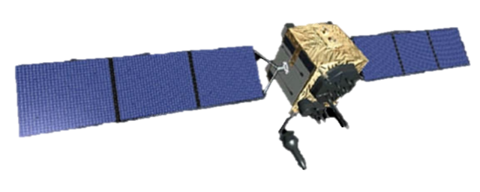
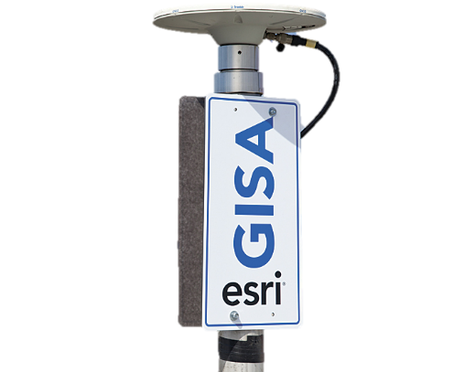
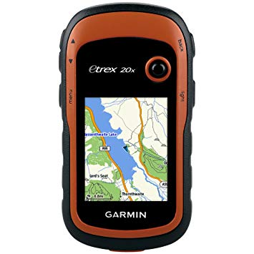
Global positioning system
Simple illustration of working GPS
A system relationship between:
  Satellites
  Receivers
  Reference stations
Notes:
A satellite sends out pulses of data giving it’s location at specific times. Receivers like the Garmin eTrex 20x pick up these signals and triangulate their own position based on signals received from satellites. The more satellite signals received, the more accurate a GPS position will be.
Reference stations are found throughout the world that give known stationary locations that GPS units reference to improve the accuracy of GPS units.

Slide 9
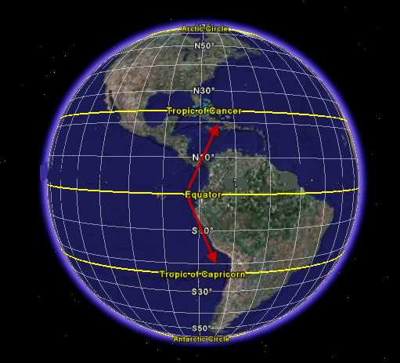
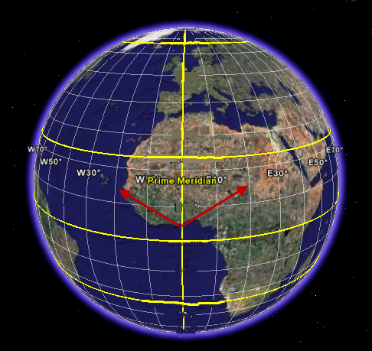
How does GPS work?
Latitude and longitude
Positions are recorded using latitude and longitude based on the WGS84 datum
Latitude measures degrees north (+) or south (-) of the Equator
Longitude measures degrees east (+) or west (-) of the Prime Meridian
Notes:
The following is a quick overview of how satellites and the GPS units work together.

Slide 10
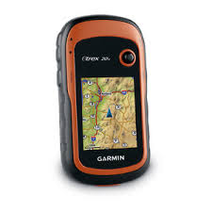
Using the
Garmin eTrex 20x

Slide 11
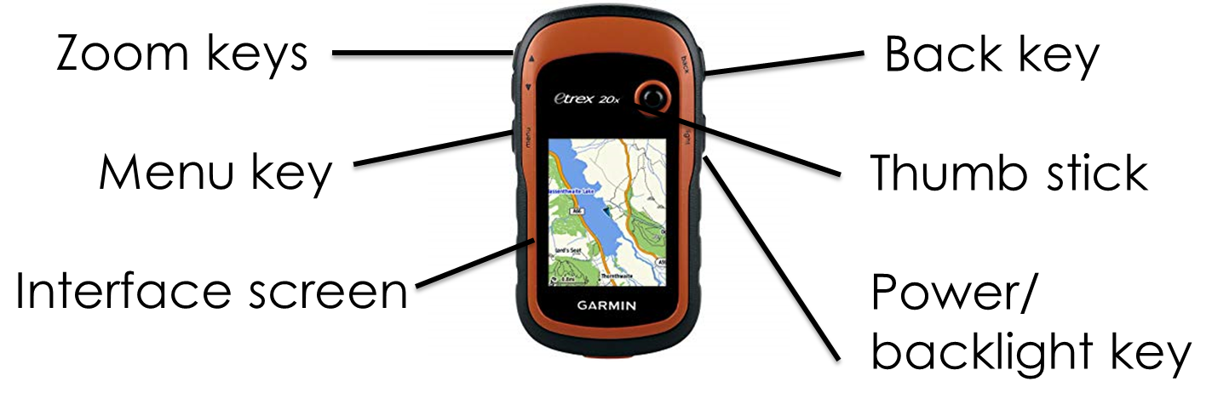
Garmin eTrex 20x
Unit overview

Slide 12
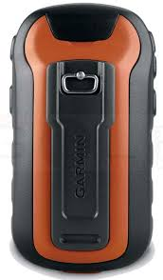
Garmin eTrex 20x
Unit overview
Mini-USB port
Locked
battery cover
Unlocked

Slide 13
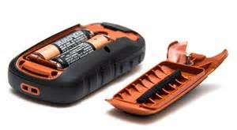
Garmin eTrex 20x
Operating the GPS
This GPS operates on two AA batteries.
To install the battery, turn the D-ring counter-clockwise and pull up to remove the cover.
Replace the battery cover and turn the D-ring clockwise to close.

Slide 14
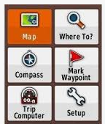
Garmin eTrex 20x
Functions we will use:
  Mark waypoint – for marking locations
  Setup – for GPS configuration
  Waypoint manager – for retrieving locations
  Satellite

Slide 15
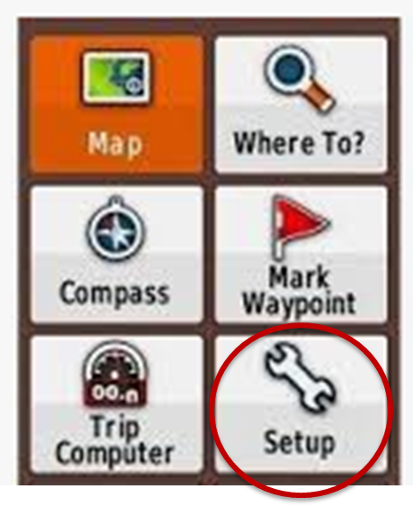
Configuring your GPS
System – Change language
and satellite system
Units – Distance/measurement
    format (e.g., metric)
Position format
    degree decimal (hddd.ddddd, WGS84)
Display – contrast
Tracks

Slide 16
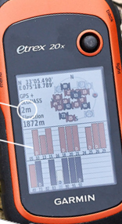
Configuring your GPS
On the menu, select Satellite.
GPS coordinates to be recorded
GPS accuracy
GPS satellite
signal strength

Slide 17
How to use GPS
To capture facility geocoordinates
Physically travel to the health facility
you wish to map
Move to a space within 10 meters
of the facility entrance
Look for a location with a clear view
of the sky
Notes:
First, you will need to be near the facility that you wish to map.
Travel to it and locate the front entrance.
A recommended standard is in an open area with a clear view of the sky within 10 meters of the entrance to the facility.

Slide 18
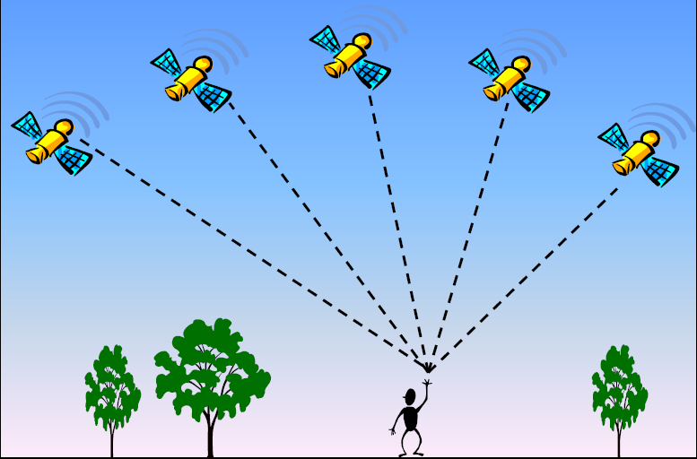
How to minimize GPS errors
Find a clear view
of the sky.
Source: Verplanke, 2007

Slide 19
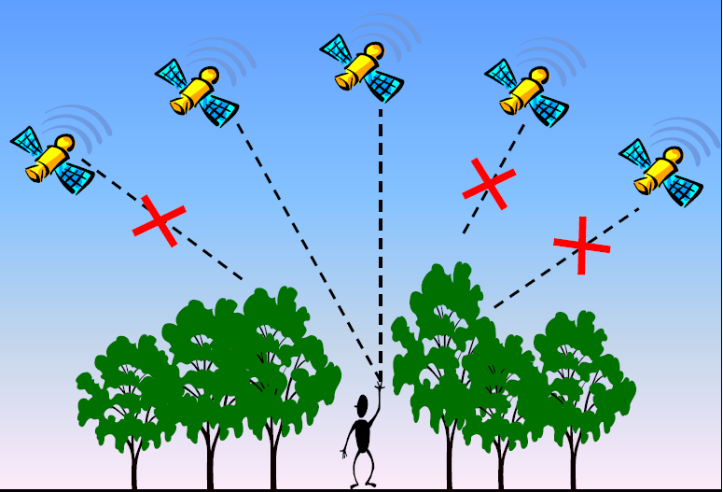
How to minimize GPS errors
Avoid tall buildings
and trees.
Source: Verplanke, 2007

Slide 20
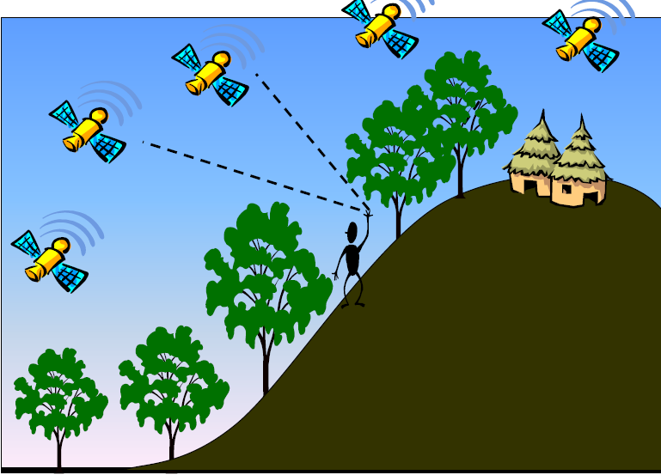
How to minimize GPS errors
In areas with a slope, try to move around.
Source: Verplanke, 2007

Slide 21
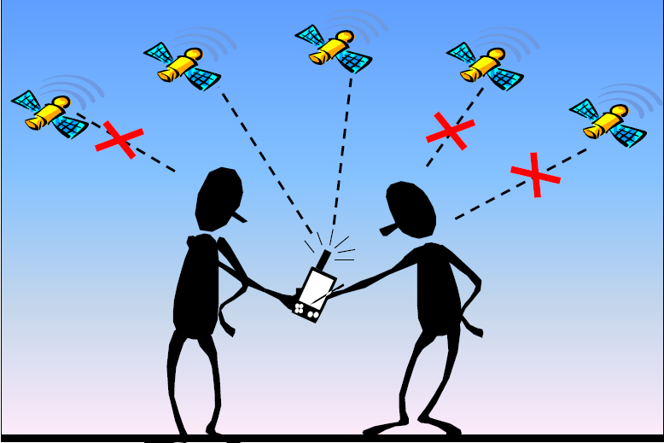
How to minimize GPS errors
Avoid covering the device with your head.
Source: Verplanke, 2007

Slide 22
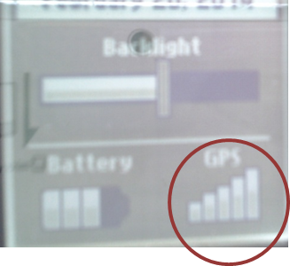
Finding your current position
After a device is turned on, it begins acquiring satellite signals
When the GPS bars on the backlight page are solid, your device has acquired satellite signals

Slide 23
Finding your current position
After acquiring enough signals:
  GPS gives accuracy of the current positions
  The desired accuracy ranges from 3m to 9m
  With desired accuracy you can now
  mark your position (waypoint)

Slide 24
Marking a waypoint
Waypoints are locations that you can mark (save in memory) for mapping activities,
as well as destinations to navigate later.
The GPS automatically assigns a numeric name to the new waypoint.
You can rename the assigned numeric name as text or numbers.

Slide 25
Marking a waypoint (2)
To mark a way point, press and hold
the thumb stick.
Rename a waypoint by using a health facility’s full name or initials.
Select Done to save the way point
in the memory.
Note: If you press and hold during saving, you will find yourself saving more than one point in one location.

Slide 26
Marking a waypoint (3)
For assurance it’s also important to record
the GPS coordinates using a form.

Slide 27
Retrieving/viewing
Go to Waypoint Manager.
  Select a waypoint to view its details.
  Press Go if you want to navigate to it.
  Or press Menu for other options.

Slide 28
Deleting a waypoint
To delete all waypoints:
  Go to Waypoint Manager, press Menu
  button and select delete.
To delete a single waypoint:
  Go to Waypoint Manager, select a point you want to delete, open it to view its particulars, press Menu button, and select delete.
Note: Please be careful when deleting a waypoint.

Slide 29
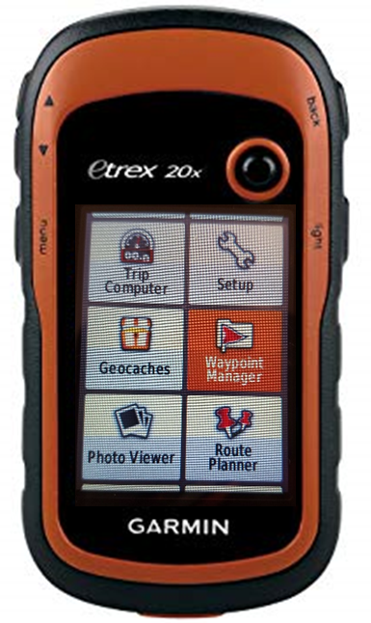
Editing a waypoint
From the main menu, navigate
to Waypoint Manager
Click the thumb stick to select

Slide 30
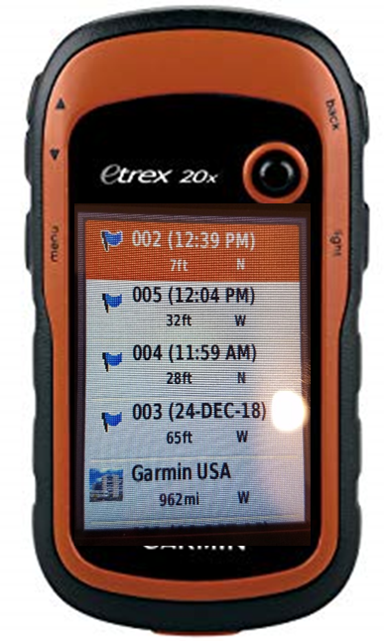
Editing a waypoint
Navigate to your recently
collected waypoint
and select it.

Slide 31
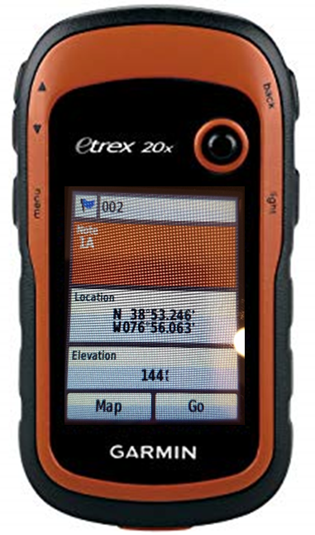
Editing a waypoint
Select Notes.
Change the name of this
section to reflect the name
of the health facility.
Select Done.

Slide 32
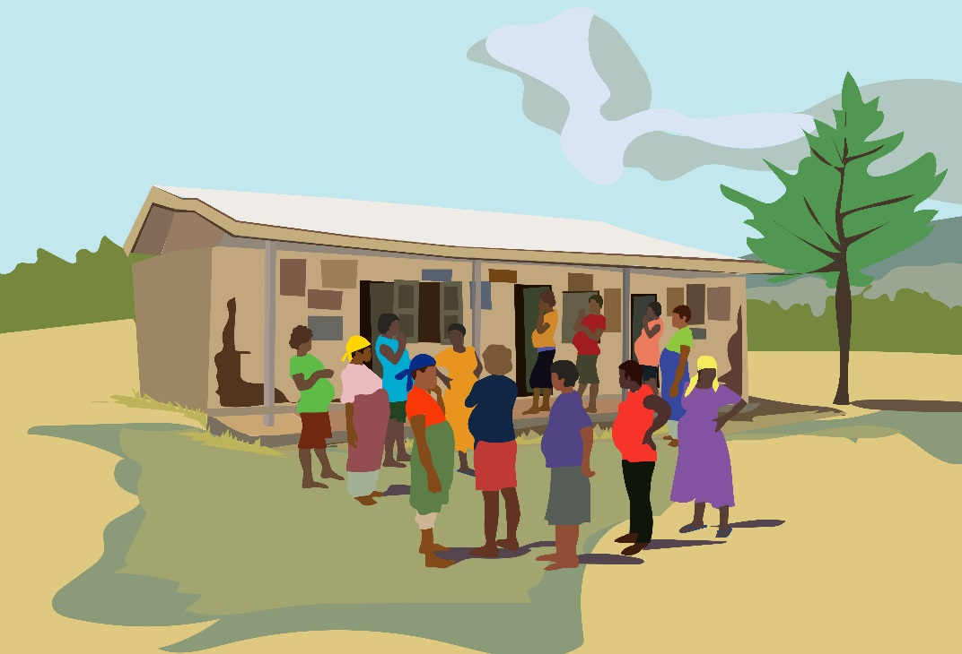
Thank you!
Thank You!

